Slide 1
CST 402 - DISTRIBUTED COMPUTING

Slide 2
Module - III

Slide 3
Module – III Lesson Plan
L1: Distributed mutual exclusion algorithms – System model, Lamport’s algorithm
L2: Ricart–Agrawala algorithm
L3: Quorum-based mutual exclusion algorithms – Maekawa’s algorithm
L4: Token-based algorithm – Suzuki–Kasami’s broadcast algorithm.
L5: Deadlock detection in distributed systems – System model, Deadlock handling strategies, Issues in deadlock detection.
L6: Models of deadlocks

Slide 4
Distributed mutual exclusion algorithms
Mutual exclusion is a fundamental problem in distributed computing systems.
Mutual exclusion ensures that concurrent access of processes to a shared resource or data is serialized, that is, executed in a mutually exclusive manner.
Mutual exclusion in a distributed system states that only one process is allowed to execute the critical section (CS) at any given time
There are three basic approaches for implementing distributed mutual exclusion:
Token-based approach.
Non-token-based approach
.Quorum-based approach.

Slide 5
Distributed mutual exclusion algorithms
In the token-based approach,
a unique token is shared among the sites (PRIVILEGE MESSAGE).
A site is allowed to enter its CS if it possesses the token and it continues to hold the token until the execution of the CS is over.
Mutual exclusion is ensured because the token is unique

Slide 6
Distributed mutual exclusion algorithms
In the non-token-based approach,
two or more successive rounds of messages are exchanged among the sites to determine which site will enter the CS next.
A site enters the critical section (CS) when an assertion, defined on its local variables, becomes true.
Mutual exclusion is enforced because the assertion becomes true only at one site at any given time.

Slide 7
Distributed mutual exclusion algorithms
In the quorum-based approach,
each site requests permission to execute the CS from a subset of sites (called a quorum).
The quorums are formed in such a way that when two sites concurrently request access to the CS, at least one site receives both the requests and this site is responsible to make sure that only one request executes the CS at any time.

Slide 8
Distributed mutual exclusion algorithms
System model
The system consists of N sites, S1, S2,... Sn ,a single process is running on each site
The process at site Si is denoted by pi.
All these processes communicate asynchronously over an underlying communication network.
A process wishing to enter the CS requests all other or a subset of processes by sending REQUEST messages, and waits for appropriate replies before entering the CS
While waiting the process is not allowed to make further requests to enter the CS.
A site can be in one of the following three states: requesting the CS, executing the CS, or neither requesting nor executing the CS (Idle state)

Slide 9
Distributed mutual exclusion algorithms
In the “requesting the CS” state, the site is blocked and cannot make further requests for the CS.
In the “idle” state, the site is executing outside the CS.
idle token state :In the token-based algorithms, a site can also be in a state where a site holding the token is executing outside the CS.
At any instant, a site may have several pending requests for CS.
A site queues up these requests and serves them one at a time.
communication channels →if they are FIFO or not→depends on the algm
assume that channels reliably deliver all messages, sites do not crash, and the network does not get partitioned

Slide 10
Requirements of mutual exclusion algms
Satisfy 3 properties
Safety property:
The safety property states that at any instant, only one process can execute the critical section.
This is an essential property of a mutual exclusion algorithm.
2. Liveness property :
This property states the absence of deadlock and starvation.
Two or more sites should not endlessly wait for messages that will never arrive.
A site must not wait indefinitely to execute the CS while other sites are repeatedly executing the CS.
That is, every requesting site should get an opportunity to execute the CS in finite time.

Slide 11
Requirements of mutual exclusion algms contd…
3. Fairness :
Fairness in the context of mutual exclusion means that each process gets a fair chance to execute the CS.
In mutual exclusion algorithms, the fairness means that the CS execution requests are executed in order of their arrival in the system

Slide 12
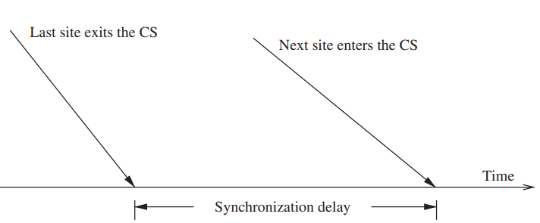
Distributed mutual exclusion algorithms
Performance metrics - 4
Message complexity : This is the number of messages that are required per CS execution by a site
Synchronization delay : After a site leaves the CS, it is the time required and before the next site enters the CS

Slide 13
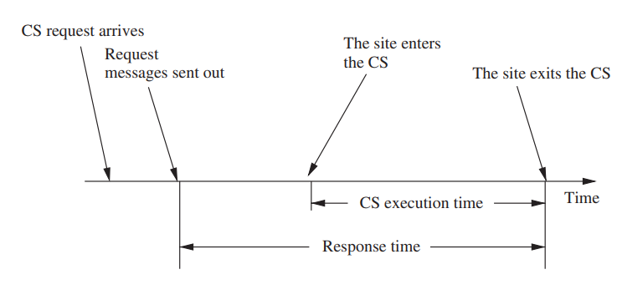
Distributed mutual exclusion algorithms
Response time : This is the time interval a request waits for its CS execution to be over after its request messages have been sent out

Slide 14
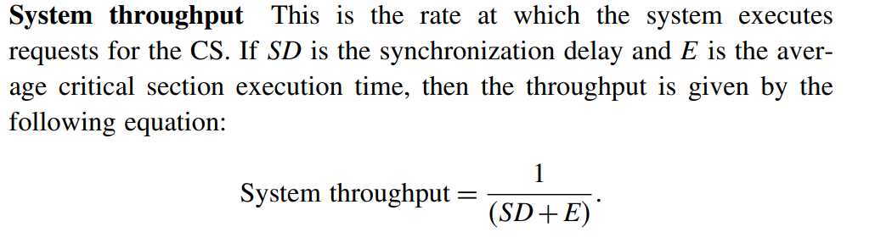
Distributed mutual exclusion algorithms
Performance metrics

Slide 15
Lamport’s algorithm
Lamport developed a distributed mutual exclusion algorithm as an illustration of his clock synchronization scheme
The algorithm is fair → a request for CS are executed in the order of their timestamps and time is determined by logical clocks.
When a site processes a request for the CS, it updates its local clock and assigns the request a timestamp.
The algorithm executes CS requests in the increasing order of timestamps.
Every site Si keeps a queue, request_queuei, which contains mutual exclusion requests ordered by their timestamps.
This algorithm requires communication channels to deliver messages in FIFO order.

Slide 16
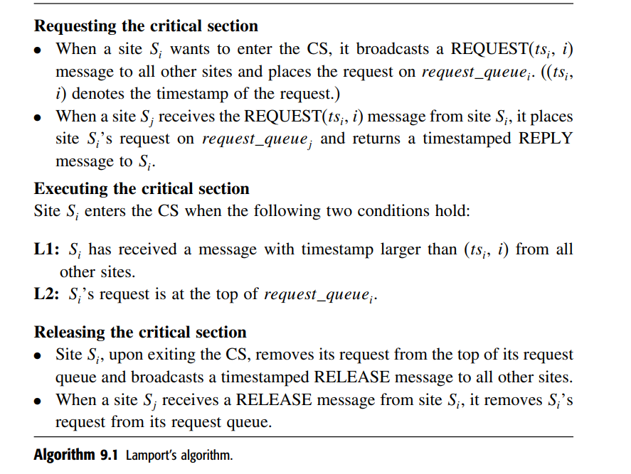
Lamport’s algorithm

Slide 17
Lamport’s algorithm
When a site removes a request from its request queue, its own request may come at the top of the queue, enabling it to enter the CS.
When a site receives a REQUEST, REPLY, or RELEASE message, it updates its clock using the timestamp in the message
Performance :
Lamport’s algorithm requires N − 1 REQUEST messages, N −1 REPLY messages, and N −1 RELEASE messages. Thus, Lamport’s algorithm requires 3(N − 1) messages per CS invocation.

Slide 18
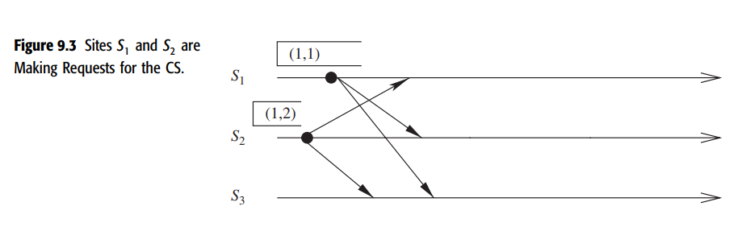
Lamport’s algorithm
sites S1 and S2 are making requests for the CS and send out REQUEST messages to other sites. The timestamps of the requests are (1,1) and (1,2), respectively

Slide 19

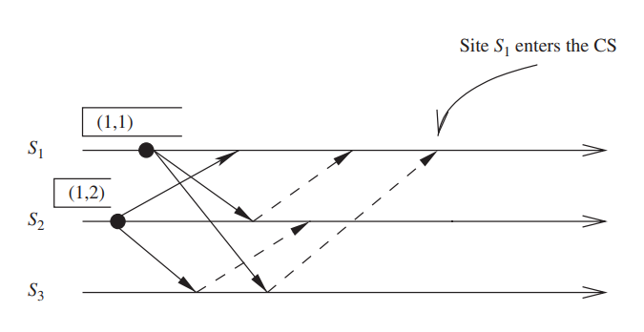
Lamport’s algorithm
both the sites S1 and S2 have received REPLY messages from all other sites.
S1 has its request at the top of its request_queue but site S2 does not have its request at the top of its request_queue.
Consequently, site S1 enters the CS

Slide 20

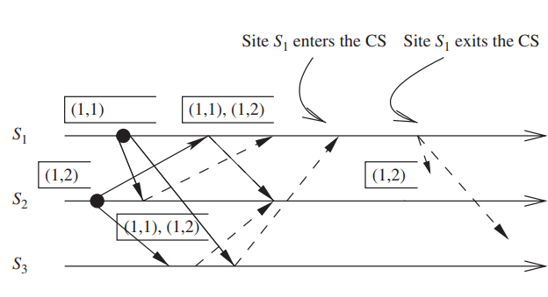
Lamport’s algorithm

Slide 21

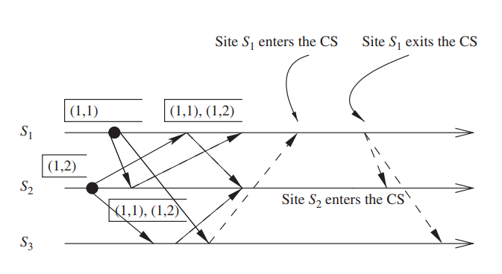
Lamport’s algorithm
site S2 has received REPLY from all other sites and also received a RELEASE message from site S1.
Site S2 updates its request_queue and its request is now at the top of its request_queue. Consequently, it enters the CS next

Slide 22
Ricart–Agrawala algorithm
The Ricart–Agrawala algorithm assumes that the communication channels are FIFO.
The algorithm uses two types of messages: REQUEST and REPLY.
A process sends a REQUEST message to all other processes to request their permission to enter the critical section.
A process sends a REPLY message to a process to give its permission to that process.
Processes use Lamport-style logical clocks to assign a timestamp to critical section requests.
Timestamps are used to decide the priority of requests in case of conflict

Slide 23
Ricart–Agrawala algorithm
if a process pi that is waiting to execute the critical section receives a REQUEST message from process pj,
then if the priority of pj’s request is lower, pi defers the REPLY to pj and sends a REPLY message to pj only after executing the CS for its pending request.
Otherwise, pi sends a REPLY message to pj immediately, provided it is currently not executing the CS.
Each process pi maintains the request-deferred array, RDi, the size of which is the same as the number of processes in the system.
Initially, ∀i ∀j: Rdi[j] = 0. Whenever pi defers the request sent by pj, it sets RDij = 1, and after it has sent a REPLY message to pj, it sets RDij = 0.

Slide 24
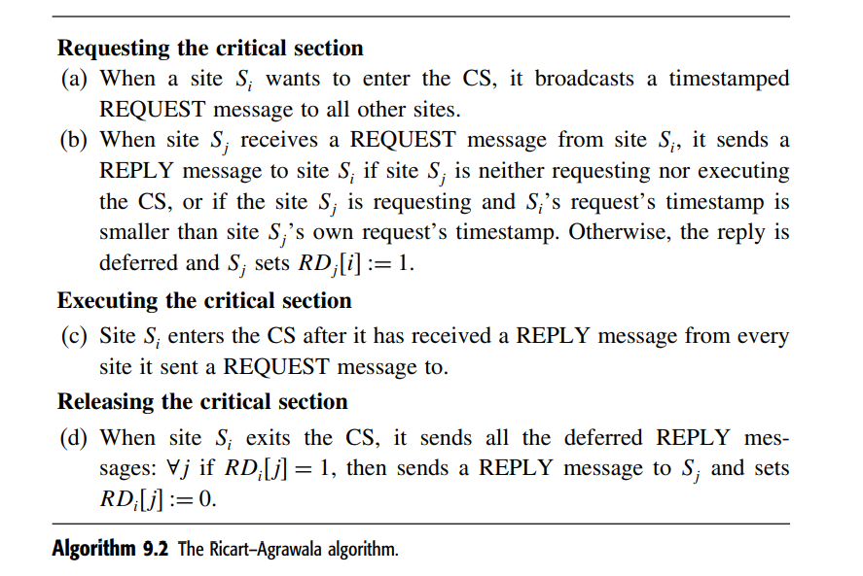
Ricart–Agrawala algorithm

Slide 25

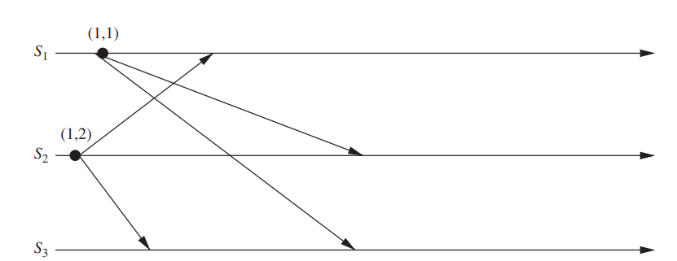
Operation of the Ricart–Agrawala algorithm

Slide 26

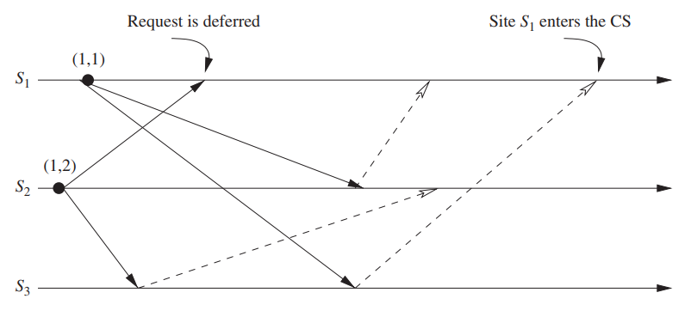
Operation of the Ricart–Agrawala algorithm

Slide 27

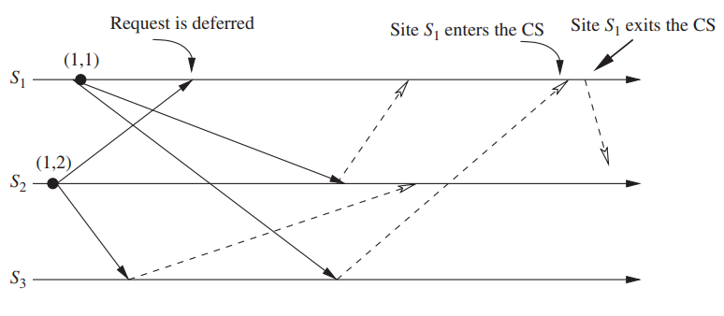
Operation of the Ricart–Agrawala algorithm

Slide 28

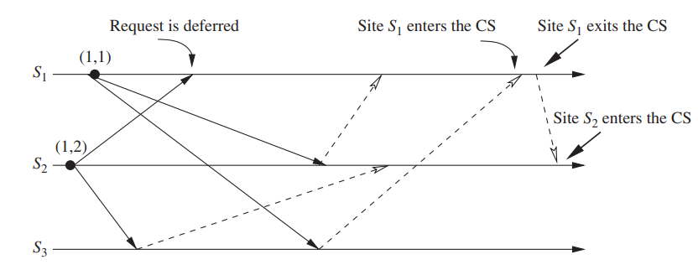
Operation of the Ricart–Agrawala algorithm

Slide 29
Ricart–Agrawala algorithm
In the Ricart–Agrawala algorithm, for every requesting pair of sites, the site with higher priority request will always defer the request of the lower priority site.
At any time only the highest priority request succeeds in getting all the needed REPLY messages
For each CS execution, the Ricart–Agrawala algorithm requires N − 1 REQUEST messages and N − 1 REPLY messages.
Thus, it requires 2(N −1) messages per CS execution

Slide 30

Quorum-based mutual exclusion algorithms
Quorum-based mutual exclusion algorithms respresented a departure from the trend in the following two ways:
A site does not request permission from all other sites, but only from a subset of the sites.
This is a radically different approach as compared to the Lamport and Ricart–Agrawala algorithms, where all sites participate in conflict resolution of all other sites
In quorum-based mutual exclusion algorithm, a site can send out only one REPLY message at any time.
A site can send a REPLY message only after it has received a RELEASE message for the previous REPLY message.
Therefore, a site Si locks all the sites in Ri in exclusive mode before executing its CS.

Slide 31
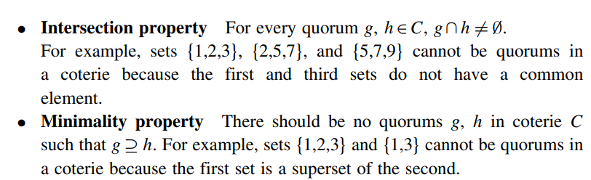
Quorum-based mutual exclusion algorithms
Quorum-based mutual exclusion algorithms→ reduce the message complexity of invoking mutual exclusion →sites ask permission from only a subset of sites
These algorithms are based on the notion of “Coteries” and “Quorums”.
A coterie C is defined as a set of sets, where each set g ∈C is called a quorum. The properties for quorums in a coterie:
Intersection property
Minimality property
Coteries and quorums can be used to develop algorithms to ensure mutual exclusion in a distributed environment

Slide 32
Quorum-based mutual exclusion algorithms
A simple protocol works as follows: let “a” be a site in quorum “A.”
If “a” wants to invoke mutual exclusion, it requests permission from all sites in its quorum “A.”
Every site does the same to invoke mutual exclusion. Due to the Intersection property, quorum “A” contains at least one site that is common to the quorum of every other site. These common sites send permission to only one site at any time. Thus, mutual exclusion is guaranteed
Minimality property ensures efficiency
Quorums are formed as sets that contain a majority of sites.
Maekawa used the theory of projective planes to develop quorums of size √N

Slide 33
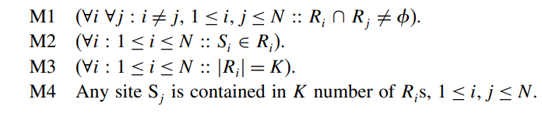
Maekawa’s algorithm
First quorum-based mutual exclusion algm
The request sets for sites (i.e., quorums) are constructed →conditions:

Slide 34
Maekawa’s algorithm
Conditions M1 and M2 are necessary for correctness
Condition M3 states that the size of the requests sets of all sites must be equal
Site->equal amount of work to invoke Mutual exclusion
Condition M4 enforces that exactly the same number of sites should request permission from any site, which implies that all sites have “equal responsibility” in granting permission to other sites
This algorithm requires delivery of messages to be in the order they are sent between every pair of sites.

Slide 35
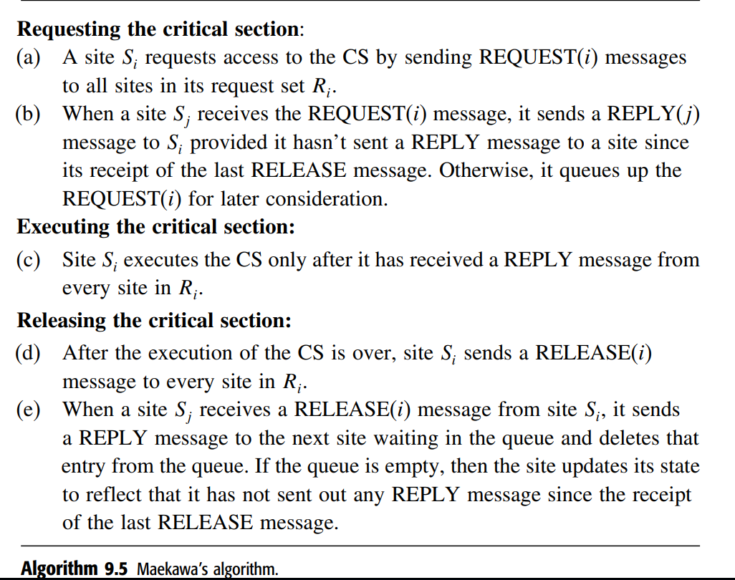
Maekawa’s algorithm

Slide 36
Token-based algorithms
In token-based algorithms, a unique token is shared among the sites.
A site is allowed to enter its CS if it possesses the token.
A site holding the token can enter its CS repeatedly until it sends the token to some other site.
Depending upon the way a site carries out the search for the token, there are numerous token-based algorithms
token-based algorithms use sequence numbers instead of timestamps.
Every request for the token contains a sequence number

Slide 37
Suzuki–Kasami’s broadcast algorithm
In Suzuki–Kasami’s algorithm if a site that wants to enter the CS does not have the token, it broadcasts a REQUEST message for the token to all other sites.
A site that possesses the token sends it to the requesting site upon the receipt of its REQUEST message.
If a site receives a REQUEST message when it is executing the CS, it sends the token only after it has completed the execution of the CS
Although the basic idea underlying this algorithm may sound rather simple, there are two design issues that must be efficiently addressed:
1. How to distinguishing an outdated REQUEST message from a current REQUEST message
2. How to determine which site has an outstanding request for the CS

Slide 38
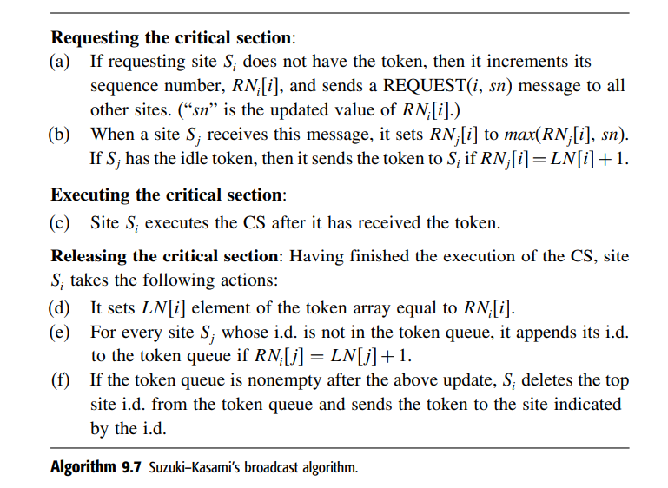
Suzuki–Kasami’s broadcast algorithm

